Slide 1
The Cell Cycle:
Mitosis
Campbell
Chapter 12

Slide 2
Why cell division?
To continue life…
Reproduction
Growth and development
Tissue renewal & repair

Slide 3
The Cell Cycle
The life of a cell from origin to division of “parent” cell into two “daughter” cells
Distributes “identical” sets of chromosomes to daughter cells
Genome~a cell’s entire collection of DNA
Chromatin~DNA-protein complex
Prokaryotes~typically one strand of DNA
Eukaryotes~usually several DNA molecules (chromosomes)
Chromosomes must replicate prior to cell division

Slide 4
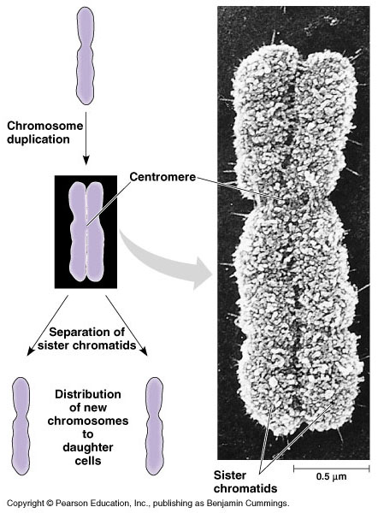
Chromosomes
molecules of DNA
all cells have chromosomes
somatic vs. germ cells
germ cells→gametes
sister chromatids are duplicated chromosomes
Single chromatids are unduplicated chromosomes
connected at waist called a centromere

Slide 5
Mitotic Cell Cycle
M Phase: mitotic phase, includes mitosis & cytokinesis
Interphase: ~90% of cell cycle; cell grows & copies chromosomes preparing for cell division
  G₁ Phase: “first gap”
  S Phase: “synthesis”
  G₂ Phase: “second gap”
a cell grows by producing proteins & cytoplasmic organelles

Slide 6
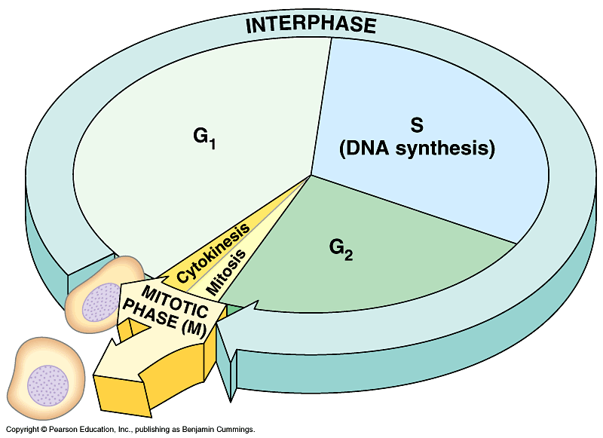

Slide 7
Cell Division: Mitosis & Cytokinesis
Mitosis: nuclear division
Cytokinesis: division of cytoplasm (after mitosis)
Mitosis
Prophase
Prometaphase
Metaphase
Anaphase
Telophase

Slide 8
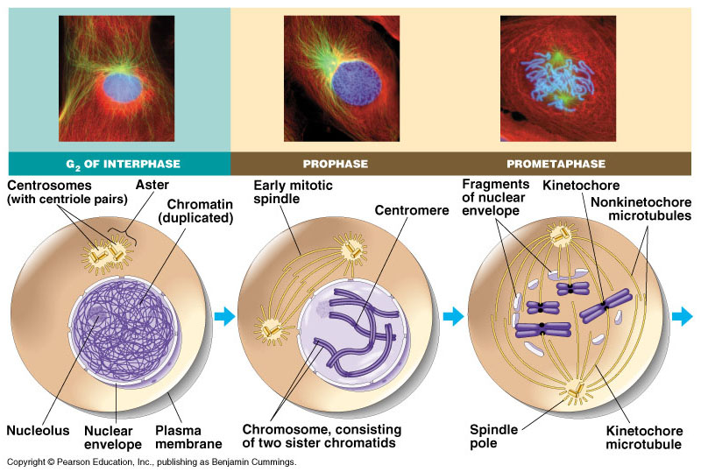
INTERPHASE
During late interphase nuclear envelope is still well-defined
DNA has been replicated (S Phase)
Chromosomes can’t be distinguished
DNA is loosely packed chromatin

Slide 9
PROPHASE
Chromatin becomes densely packed, visible chromosomes
Mitotic spindle begins to form from centrosomes
The centrosomes start to move to opposite sides of the cell
Nucleolus disappears

Slide 10
PROMETAPHASE
Nuclear envelope breaks down
Spindles start to invade the nuclear space
Spindles attach to the kinetochore of each chromosome
Kinetochore is located at the centromere region of each chromosome

Slide 11
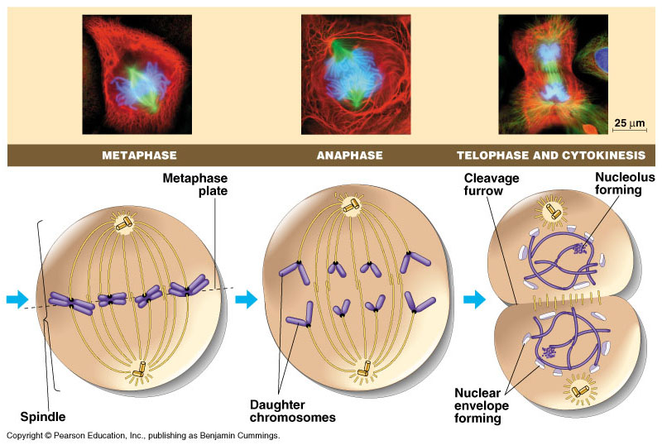
METAPHASE
Centrosomes are now at opposite ends of the cell
Chromosomes line up at the metaphase plate (cell’s equator)

Slide 12
ANAPHASE
Paired centromeres of each chromosome separates
Thus, sister chromatids are split apart
Each chromatid is now considered a chromosome (“unduplicated”)
At the end, each pole should have equivalent & complete collections of chromosomes

Slide 13
TELOPHASE
Spindle fibers break down
Nuclear envelope reforms
Chromosomes become less tightly coiled
Nucleolus reforms
Mitosis ENDS!

Slide 14
CYTOKINESIS
Cell division of cytoplasm
2 daughter cells form
Animal cells-cleavage furrow
Plant cells-cell plate
Cell Division ENDS!

Slide 15
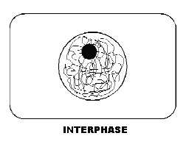

Slide 16
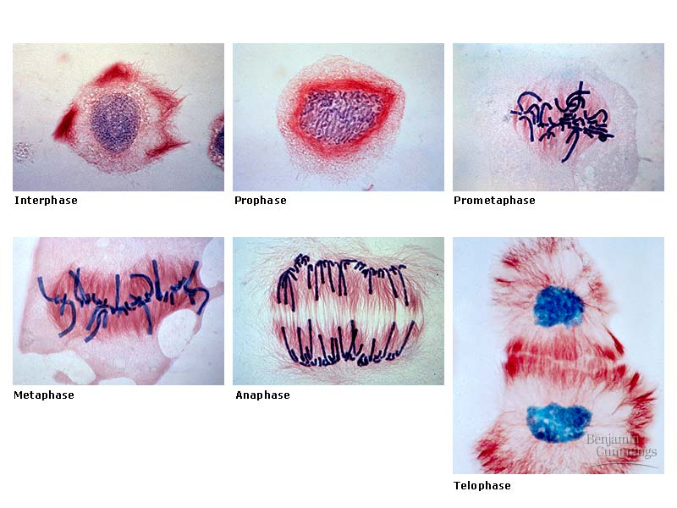

Slide 17
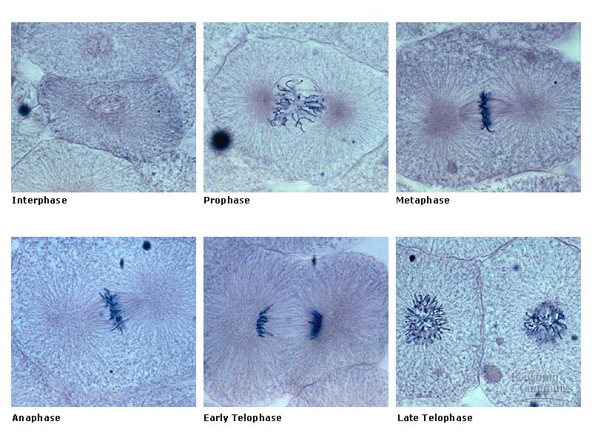

Slide 18
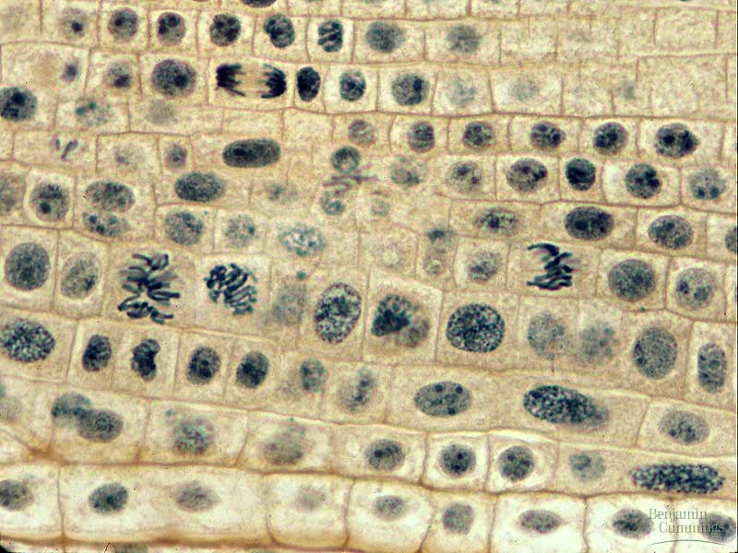

Slide 19
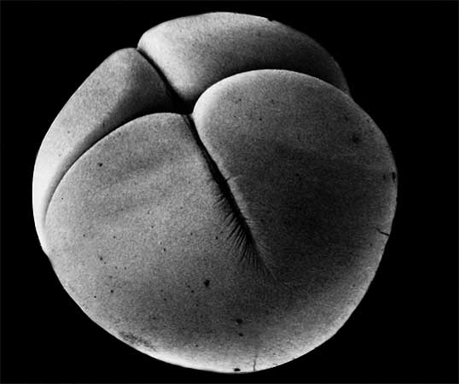

Slide 20
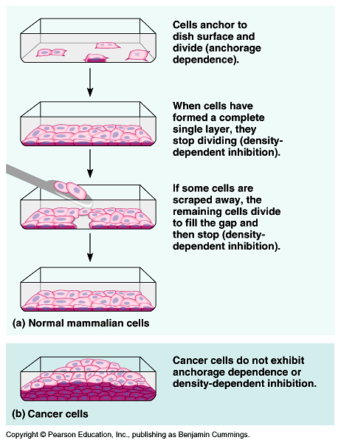
Cell Cycle Control
Internal & external cues regulate cell cycle
Divide frequently~skin cells
Have the ability to divide~but keep it in reserve (liver cells) – G_{o}
Don’t divide after maturity~nerve & muscle cells -- G_{o}
Molecular control system~driven by controls in the cytoplasm
Series of checkpoints insure a cell only moving on when all is “ready”
Growth factors are proteins that stimulate cell division
Anchorage dependence
Density-dependent inhibition

Slide 21
CANCER CELLS
break the rules:
usually arise in one of the checkpoints
plasma membrane & cytoplasm change – transformation
grow & divide abnormally – cause tumors
have a weakened capacity for adhesion
cancer cells are lethal

Slide 22
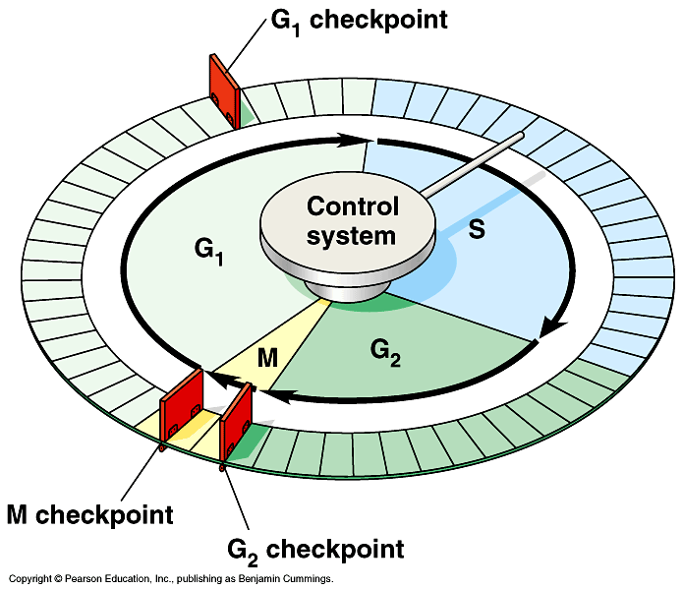

Slide 23
Some terms you should know…
Cyclins—family of proteins that activate kinases to control cell division
CDKs—cyclin-dependent kinases
MPF—mitosis promoting factor that promotes the entrance into mitosis from the G2 phase by phosphorylating multiple proteins needed during mitosis

Slide 24
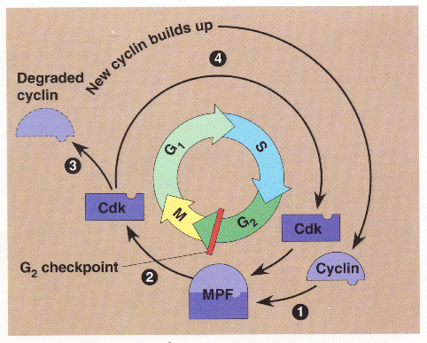

Slide 25
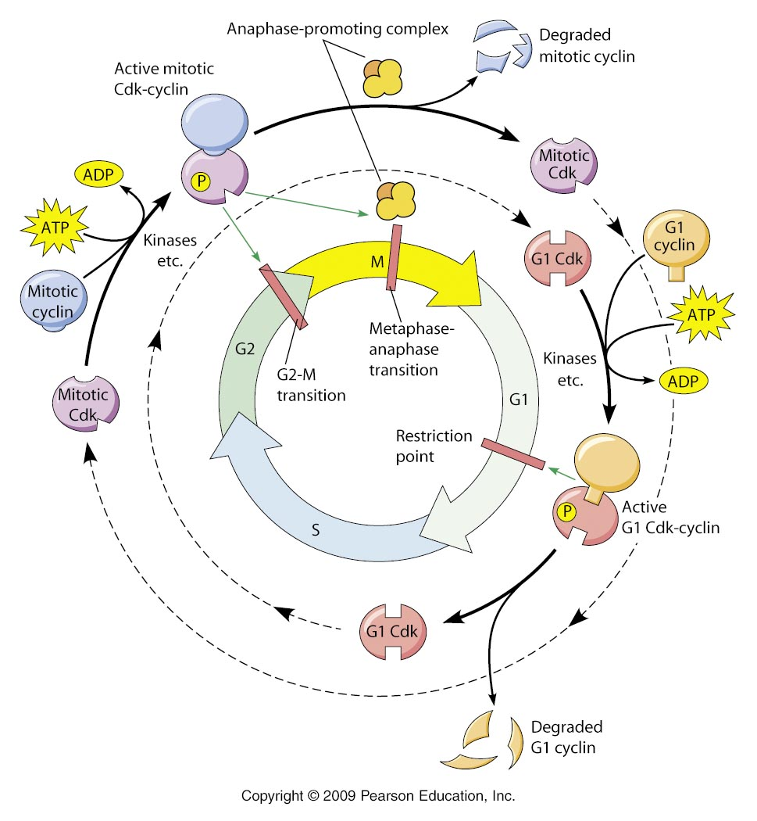

Slide 26
Use for chapter 18

Slide 27
Oncogenes and the Cell Cycle
Ras gene
Class of small protein called GTPase involved in cellular signal transudction
“Rat sarcoma”
Mutations in Ras gene keep signaling active, resulting in overactive cell growth and division
20-25% of all humans tumors have Ras mutations and inhibitors are being studied

Slide 28
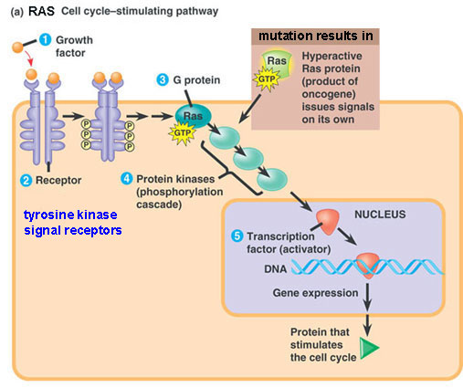

Slide 29
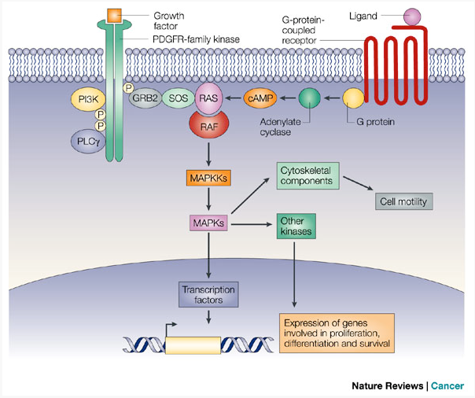

Slide 30
p53
Tumor suppressor protein
Anti-cancer functions, including inhibiting cell cycle at the G1/S checkpoint if DNA is damaged and can be repaired
Can initiate apoptosis if DNA cannot be repaired
Mutation(s) in p53 can allow damaged DNA to be passed to daughter cells during mitosis
HPV (human papilloma virus) can inactivate p53, leading to cervical cancer (e.g., Henrietta Lacks)

Slide 31
